Slide 1
Future Cosmic Surveys
DOE OHEP Cosmic Visions: Dark Energy
NAC’s “A Strategy to Optimize the U.S. Optical and Infrared System in the Era of LSST” (Elmegreen report)
Report on Kavli Futures Symposium (NOAO,LSST): “Maximizing Science in the Era of LSST: A community Based Study of Needed U.S. OIR Capabilities”

Slide 2
Cosmic Visions: Dark Energy
The Cosmic Visions Dark Energy group was formed by the DOE’s Office of High Energy Physics in August 2015: Scott Dodelson (Chair), Katrin Heitmann, Chris Hirata, Klaus Honscheid, Aaron Roodman, Uros Seljak, Anze Slosar, Mark Trodden.
Two other CV groups (CMB and Dark Matter).
CMB is in a different phase: they have released a first version of their Science Book (1610.02743). CVDE is about 1-2 years away from that.

Slide 3
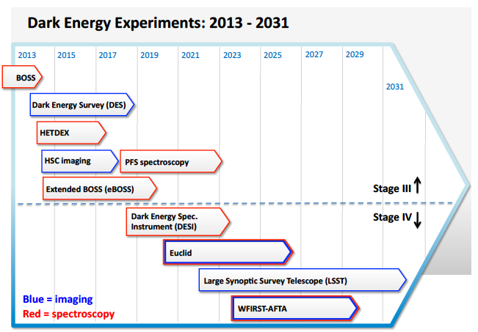
Context

Slide 4
Process
Between formation and the end of January 2016, the group of eight members held weekly telecons. Representatives of the group met with leaders of DESI at their November collaboration meeting and with leaders of the LSST Dark Energy Science Collaboration at their October collaboration meeting. There were three workshops held to gather input for the three white papers:
Brookhaven, October 1, 2015. Agenda and slides available at https://indico.bnl.gov/categoryDisplay.py?categId=124
Fermilab, November 10, 2015. Agenda and slides available at https://indico.fnal.gov/conferenceOtherViews.py?view=standard\&confId=10639
SLAC, November 13, 2015. Agenda and slides avaiable at https://indico.fnal.gov/conferenceDisplay.py?confId=10842
The group of eight met for a one day face to face meeting on January 14, 2016 at Fermilab.
Two papers were submitted to the arXiv:
1604.07626
1604.07821

Slide 5
Findings
[1] Even after DESI and LSST, there will be a lot of information left in the sky

Slide 6
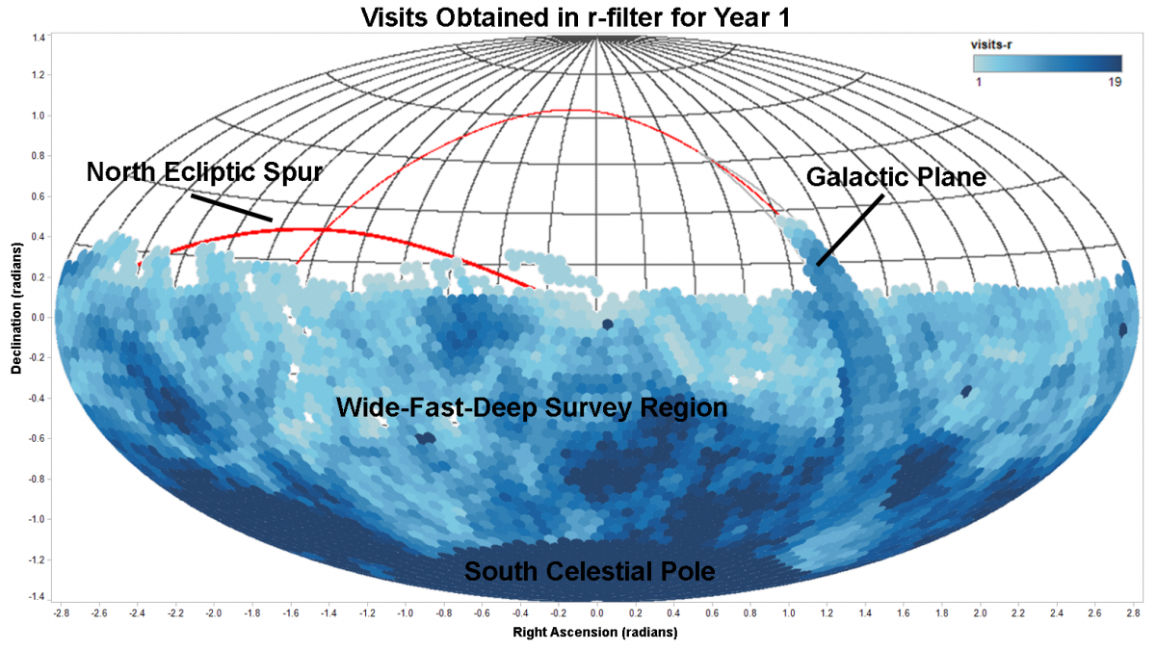
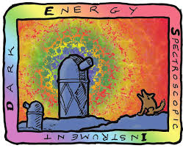
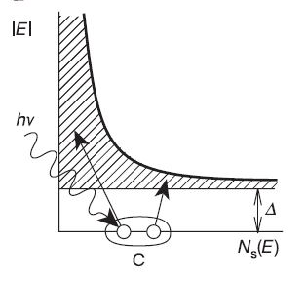
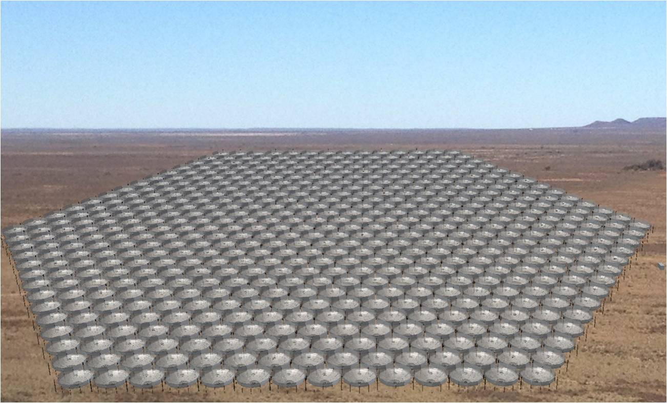
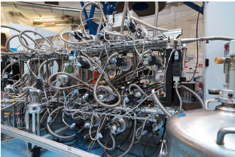
Findings
Southern Spectroscopic Survey Initiative
DESI-2
Billion Object Apparatus
21 cm
Low Resolution Spectroscopy
[2] There are multiple ideas for future projects that can mine that information

Slide 7
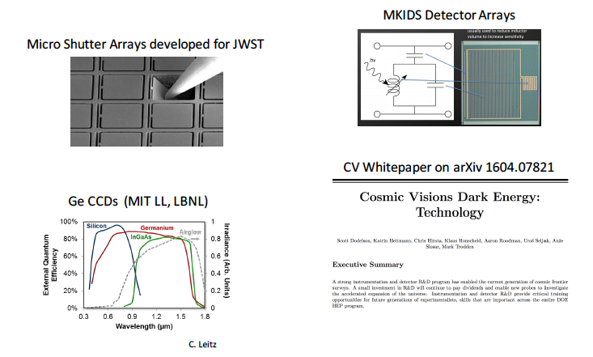
Findings
[3] Instrumentation R&D and new technologies will be key for most of these ideas

Slide 8
Recent Activity
Cosmology using Low-Resolution Spectroscopy https://kicp-workshops.uchicago.edu/LowResCosmology2020/overview.php (35 participants)
SSSI https://indico.hep.anl.gov/indico/conferenceDisplay.py?ovw=True&confId=1035 (40)
Future Cosmic Surveys https://kicp-workshops.uchicago.edu/FutureSurveys/index.php (145)

Slide 9
DESI-2

Slide 10
SSSI

Slide 11
Low-Res Spectroscopy

Slide 12
21 cm

Slide 13
BOA

Slide 14
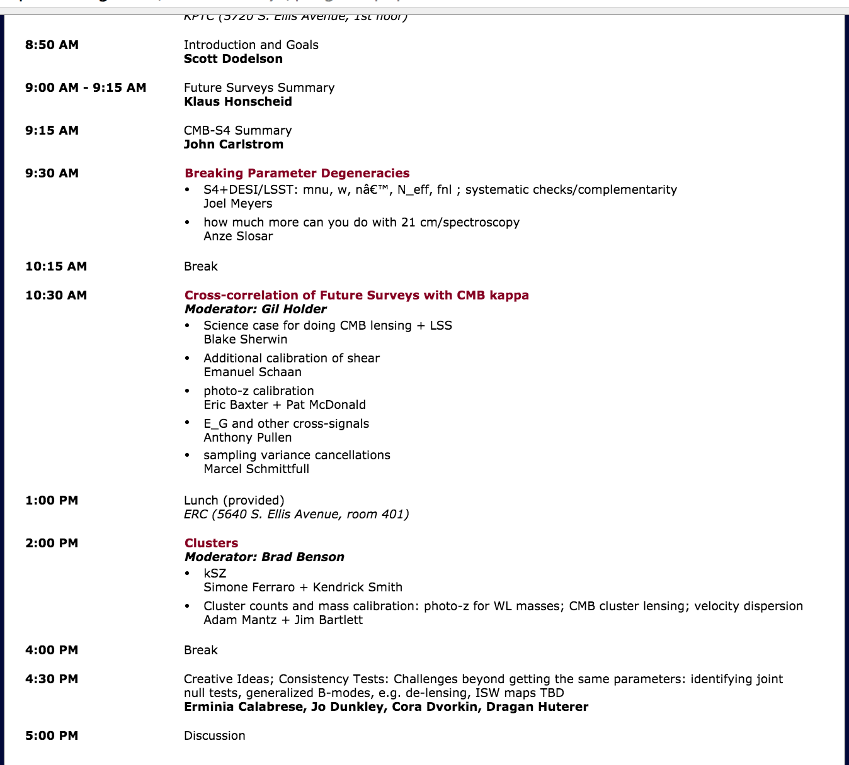
Overlap Day with CMB-S4

Slide 15
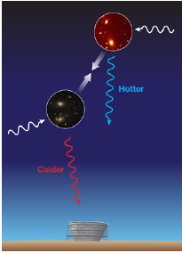
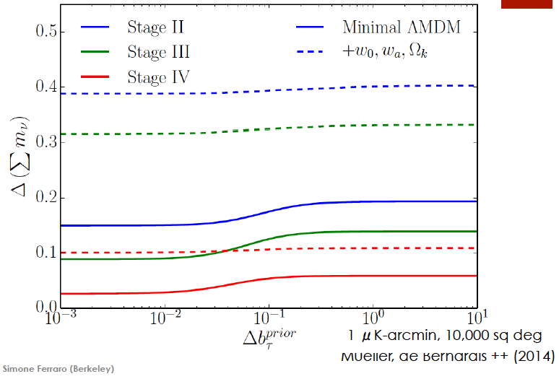
Overlap with CMB: kinetic Sunyaev-Zel’dovich Effect (kSZ)

Slide 16
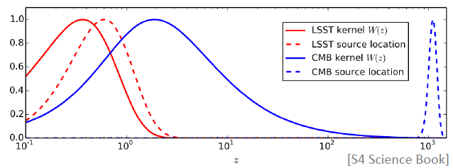
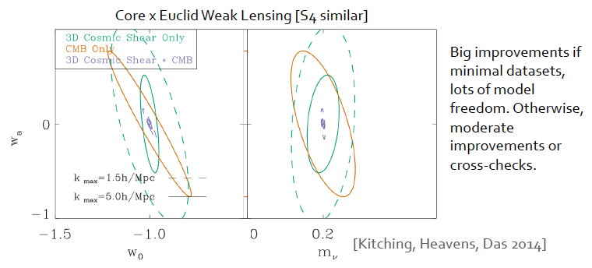
Overlap with CMB: Lensing

Slide 17
Next Steps
Proceed together generating projections over the next 6 months-one year, with telecons once every 2 months
Git Organization: allows for code sharing, prediction comparisons, writing, issues, …
Another workshop in one year with the goal of starting writing by then
One “Book” with chapters for each project? Separate books?
One idea: Put DESI-like instrument on large telescope (SSSI) in ~2025 and then upgrade in ~2030 to get BOA

